Slide 1
Employee attrition analysis
Mythili k s
Dads oct-batch

Slide 2
summary
Data Preparation
Data Transformation
Chart Preparation
Dashboard Preparation
Report
Conclusion

Slide 3
Data preparation
Chose the dataset – Employee Attrition
Imported Dataset into PowerBi
Transformed Dataset

Slide 4
Data transformation
Cleaned the Dataset
Append the tables
Handled missed values
Standardized Datatypes
Created Measures using DAX function

Slide 5
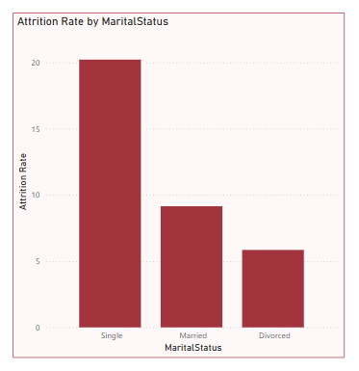
Chart preparation
Analyzed dataset
Prepared charts
Formatted Charts

Slide 6
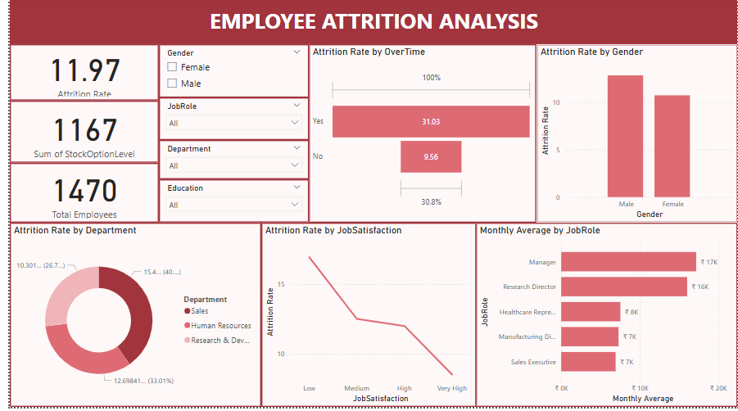
Dashboard preparation
Using Charts prepared dashboard
Added Slicers
Inserted KPI’s

Slide 7
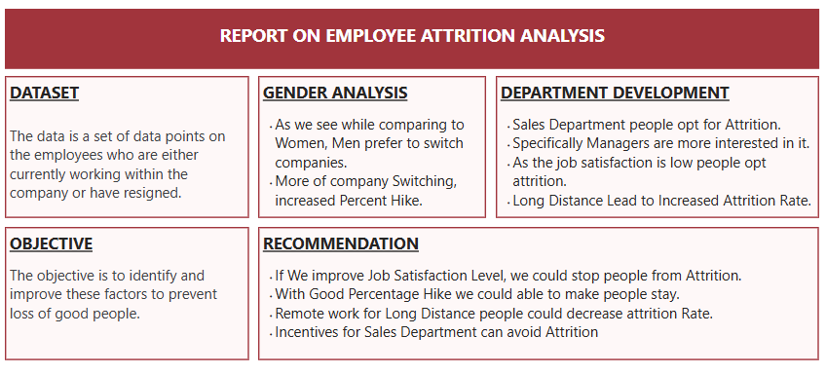
reports
A brief description of the dataset
Key observations and trends
Recommendations or actions

Slide 8
Conclusion
Improve Job Satisfaction Level
Percentage Hike
Remote work
Incentives for Sales Department

Slide 9
THANK YOU

